Slide 1

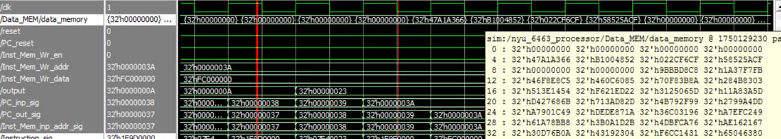
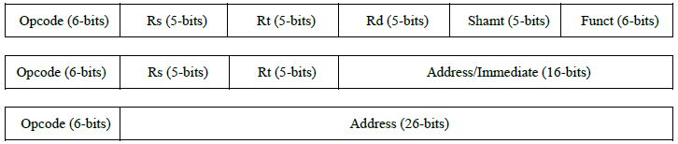
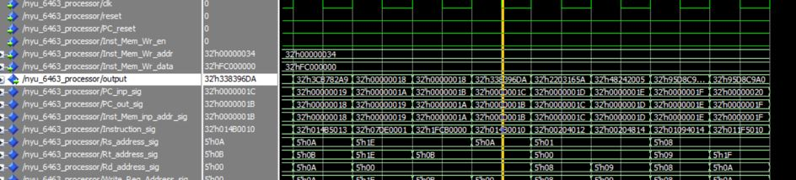
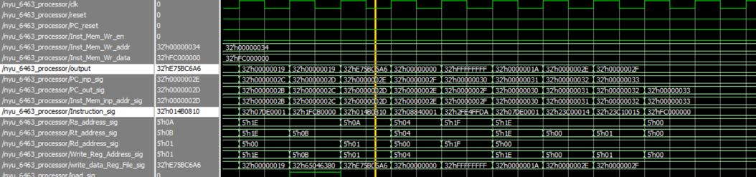
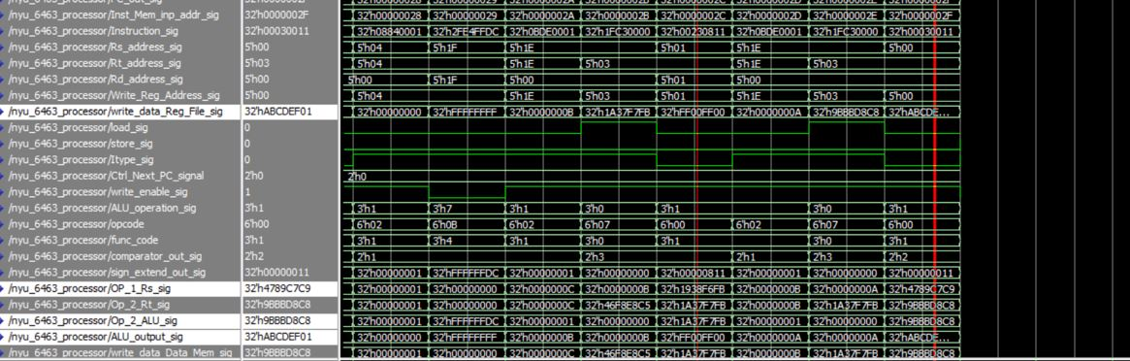
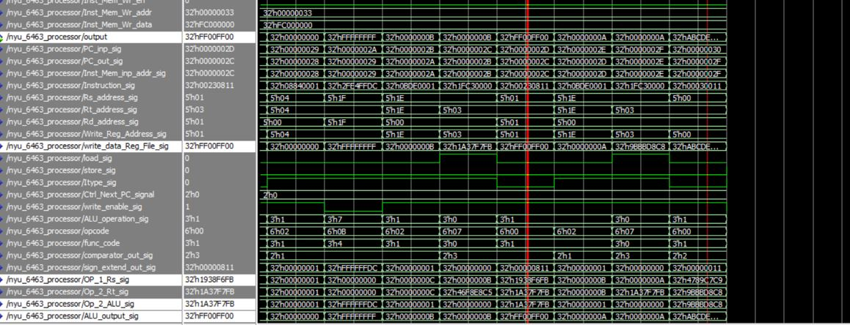
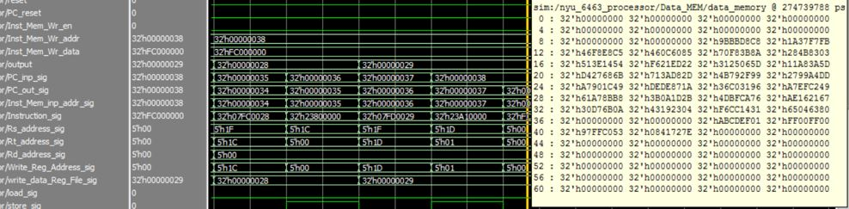
32 BIT MIPS PROCESSOR
Raj Kamal, Pankaj Subhash Yewale, Utkarsh Gautam, Albin Gomes, Sagar Panchal
PROJECT ABSTARCT
RC 5 FLOWCHARTS
SIMULATION RESULTS
The project achieves a successful design of 32-Bit, single cycle MIPS processor and implementation of RC 5 Encryption, Decryption and Key Expansion. The project utilizes Xilinx ISE and VHDL to design the processor and implement the encryption algorithm. Model SIM is used to simulate and verify the results. The design is finally implemented on the Artix-7 FPGA Nexys 4 DDR Board.
COMPILER
Key Expansion Results
MIPS ARCHITECTURE
Encryption results (A12)
Encryption results (B12)
Decryption results (A initial)
DECODER UNIT
Decryption results (B initial)
Final Data Memory outputs

